Slide 1
Fundamentals of Programming
Character & String

Slide 2
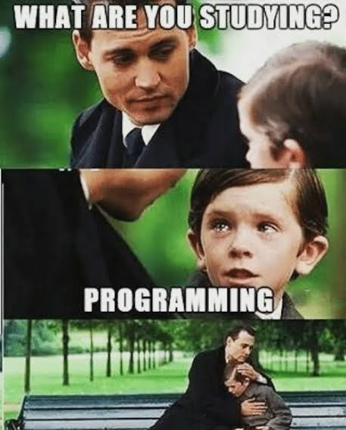

Slide 3


Slide 4
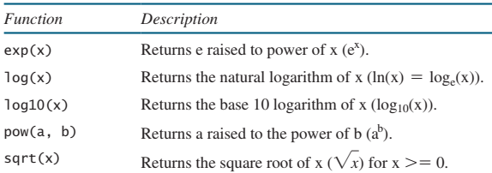
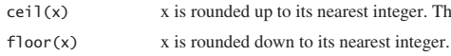
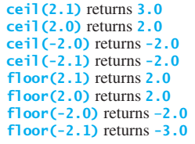
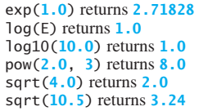
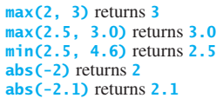
Mathematical Functions

Slide 5

Character Data Type and Operations
The character data type, char, is used to represent a single character
A character literal is enclosed in single quotation marks
The first statement assigns character A to the char variable letter. The second statement assigns digit character 4 to the char variable numChar
A string literal must be enclosed in quotation marks (“ "). A character literal is a single character enclosed in single quotation marks (' '). Therefore, "A" is a string and 'A‘ is a character

Slide 6
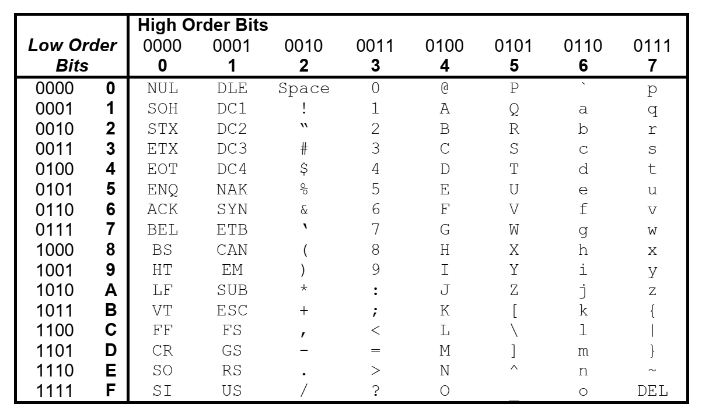
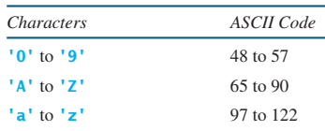
Character Data Type and Operations

Slide 7
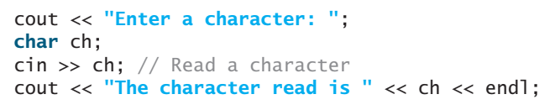

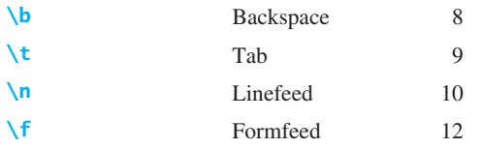
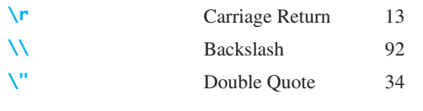
Character Data Type and Operations
To read a character from the keyboard, use
Escape Sequence
The characters ' ', '\t', '\f', '\r', and '\n' are known as the whitespace characters

Slide 8


Casting between char and Numeric Types
Output?

Slide 9
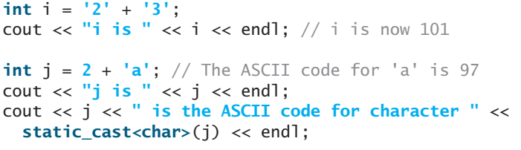

Casting between char and Numeric Types

Slide 10
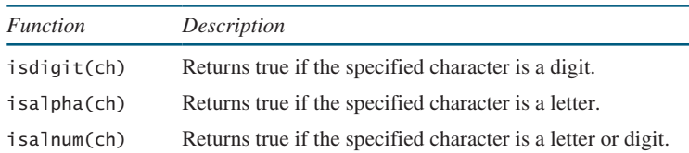
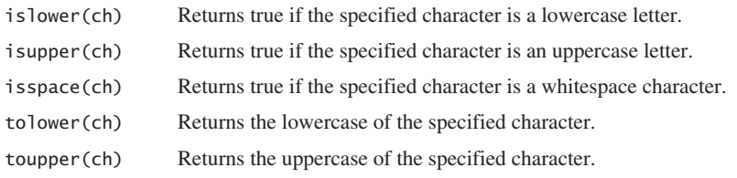
Character Functions

Slide 11
Comparing and Testing Characters ]
'a' < 'b' is
true because ASCII code for 'a' (97) is less than 'b' (98)
'a' < 'A' is
false because ASCII code for 'a' (97) is greater than 'A' (65)
'1' < '8'is
true because ASCII code for '1' (49) is less than code '8' (56)
‘a’ == ‘a’ is
true

Slide 12
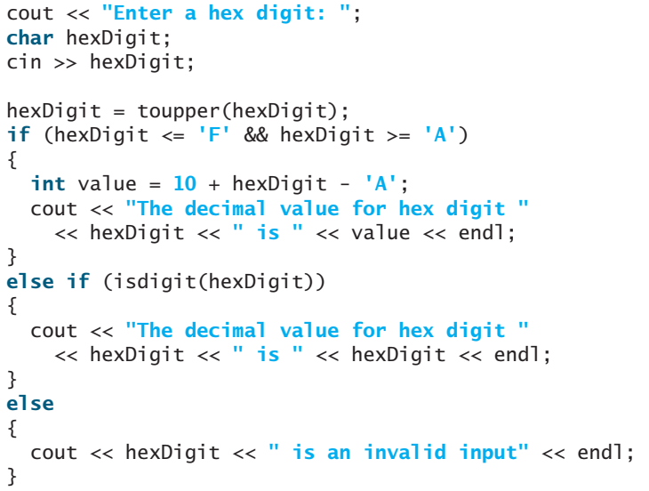
Hexadecimal Digit to a Decimal Value
Hex digits: 0–9, A–F

Slide 13
The string Type
A string is a sequence of characters.
To represent a string, use the data type called string.
For example, the following code declares that message to be a string with the value I am learning programming.
The string type is not a primitive type. It is known as an object type. Here message represents a string object with contents Programming is fun. Objects are defined using classes. string is a predefined class in the <string> header file.

Slide 14
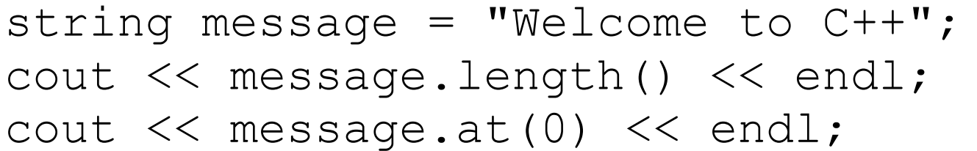
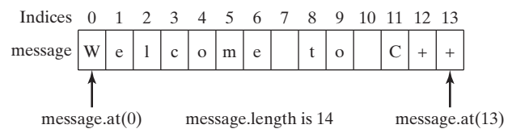
The string Type
The length() function return length of a string and at(index) function returns character at the specified index. Run and see the output of the following code.

Slide 15
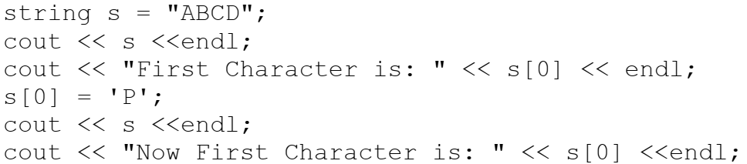
The string Type
subscript operator enables access to character at a specified index in a string using the syntax stringName[index]
For example, the following code sets a new character P at index 0 using s[0] = 'P' and displays it.

Slide 16
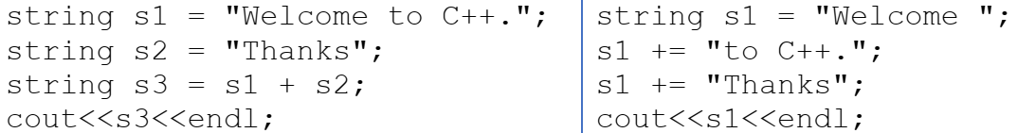
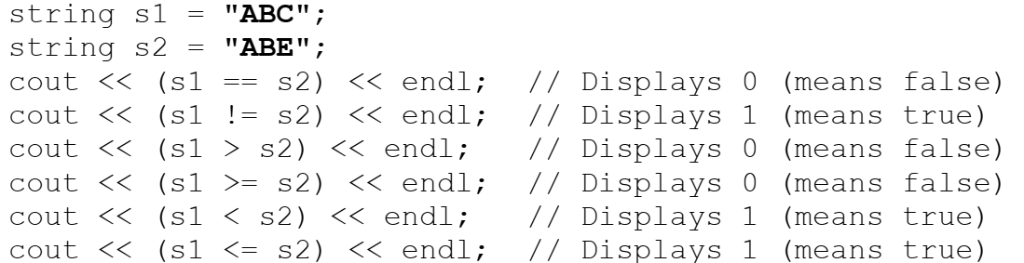
The string Type
The + and += operator concatenates two strings. For example
The string objects can be compared using relational operators. For example

Slide 17
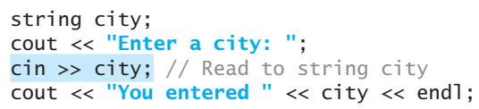
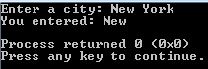
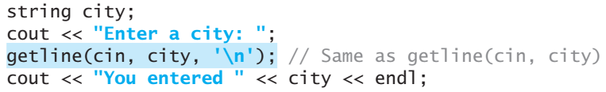
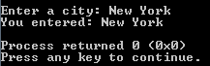

The string Type
This approach to reading a string is simple, but there is a problem.
The input ends with a whitespace character

Slide 18
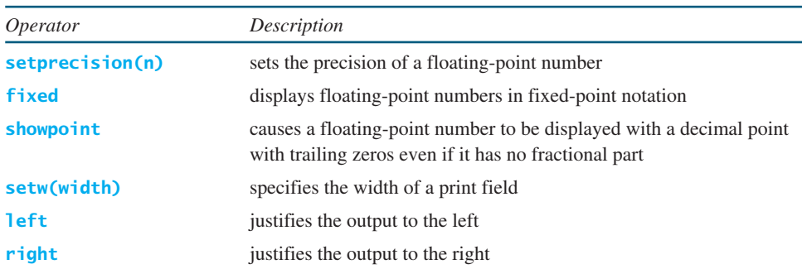
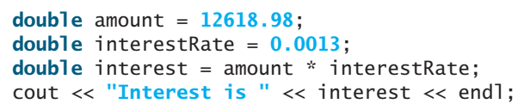

Formatting Console Output
You can use the stream manipulators to display formatted output on the console.

Slide 19
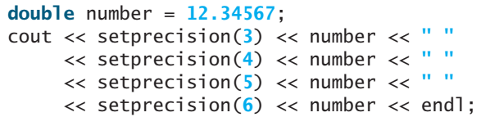

Formatting Console Output
You can specify the total number of digits displayed for a floating-point number using the setprecision(n) manipulator, where n is the number of significant digits (i.e., the total number of digits that appear before and after the decimal point)

Slide 20
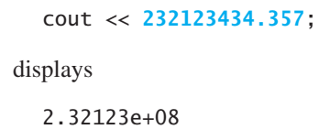
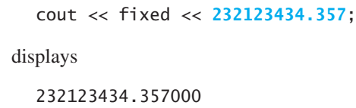
Formatting Console Output
Sometimes, the computer automatically displays a large floating-point number in scientific notation.
You can use the fixed manipulator to force the number to be displayed in nonscientific notation with a fixed number of digits after the decimal point

Slide 21
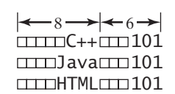





Formatting Console Output
By default, cout uses just the number of the positions needed for an output. You can use setw(width) to specify the minimum number of columns for an output. For example,
You can use the left manipulator to left-justify the output and use the right manipulator to right-justify the output. For example,

Slide 22
Thanks

